Slide 1

Docker & Daily DevOps
Tangerang, June 26th 2016

Slide 2
Hello!
I am Satria Ady Pradana
A man who is obsessed to low level technology.
Member of Dago Cybernesha team.

Slide 3
Virtualization is like a Swiss army knife. You can use it in a number of different situations

Slide 4
Introduction to Docker & Container
1
Let’s start with basic question.

Slide 5
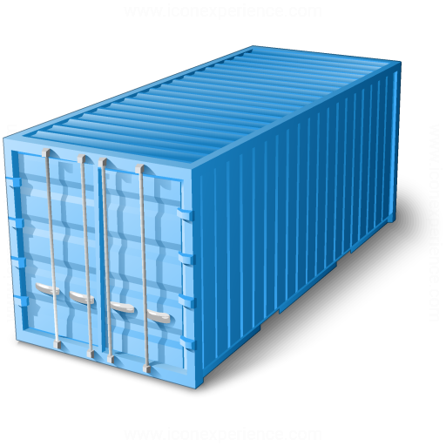
IS
A lightweight virtual machine
container

Slide 6
Why is Docker Awesome?
It’s like a Virtual Machine, but much lightweight.
Can up and run in few seconds.
Easy deploy, easy remove.
Clear separation of concerns.
Scale more easily
Get higher density and run more workloads

Slide 7
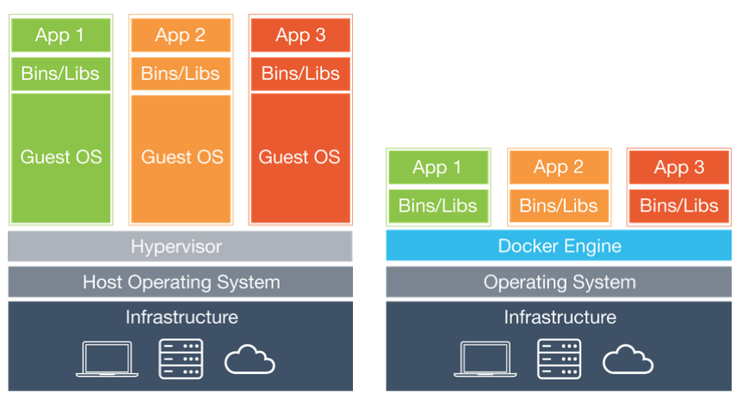
Spot the Difference
Virtual Machine
Container

Slide 8
Container
Isolated environment, but share OS and appropriate bins / libraries.

Slide 9
Some notes
VMs are very large, which makes.
Virtual Machine
Impractical to store and transfer.
If you want to replicate a VM which used as a service, you need full VM for each of instance.
1 GB space for 1 instance = 1 TB for 1000 instance.
Container
Share a bulk of space to hundred or thousands of containers, thanks to union file system.

Slide 10
Some notes
Resource utilization
Virtual Machine
Full virtualized system means allocate resource to specific VM.
Heavier!
Container
No need to create virtual device. All container share host, running on top op same kernel but isolated.

Slide 11
Some notes
Performance
Virtual Machine
Takes minutes to start.
Container
Take a few seconds, mostly.

Slide 12
The usage?
Let’s talk in an analogy

Slide 13
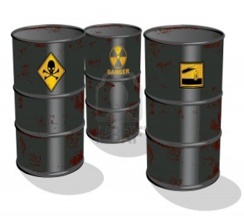
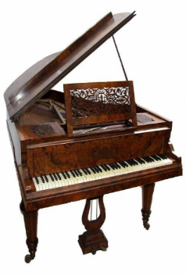
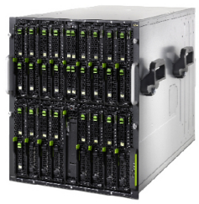
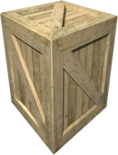
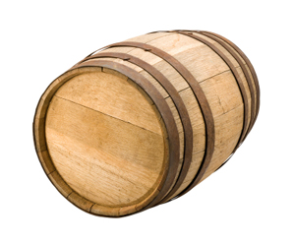
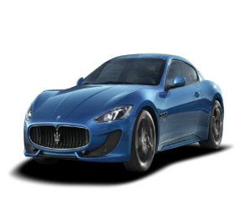
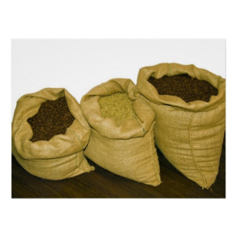



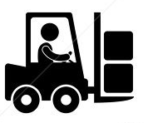
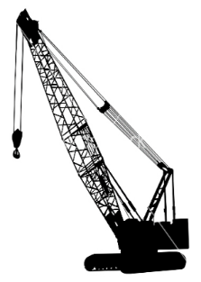
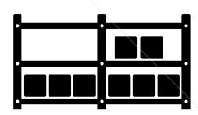

Cargo Transport Pre-1960
Do I worry about how goods interact (e.g. coffee beans next to spices)
Multiplicity of Goods
Multipilicity of methods for transporting/storing
Can I transport quickly and smoothly
(e.g. from boat to train to truck)

Slide 14





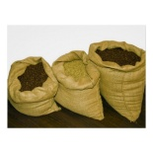






Then we have NxN Matrix
 | ? | ? | ? | ? | ? | ? | ?
 | ? | ? | ? | ? | ? | ? | ?
 | ? | ? | ? | ? | ? | ? | ?
 | ? | ? | ? | ? | ? | ? | ?
 | ? | ? | ? | ? | ? | ? | ?
 | ? | ? | ? | ? | ? | ? | ?

Slide 15



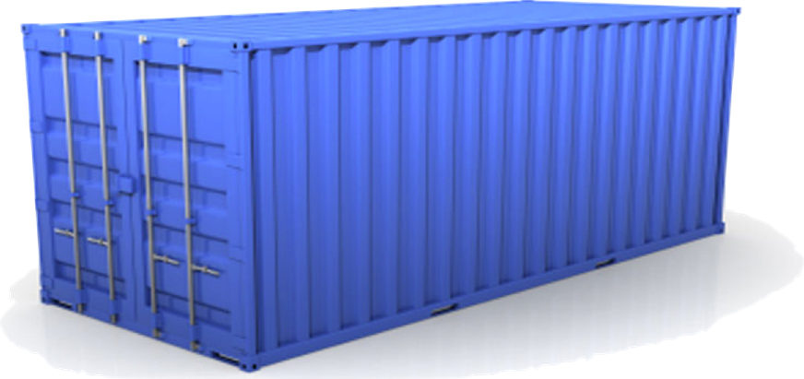
Solution: Intermodal Shipping Container
Do I worry about how goods interact (e.g. coffee beans next to spices)
Multiplicity of Goods
A standard container that is loaded with virtually any goods, and stays sealed until it reaches final delivery.
…in between, can be loaded and unloaded, stacked, transported efficiently over long distances, and transferred from one mode of transport to another
Can I transport quickly and smoothly
(e.g. from boat to train to truck)
Multiplicity of methods for transporting/storing

Slide 16
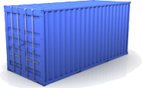

This eliminated the NXN problem…

Slide 17
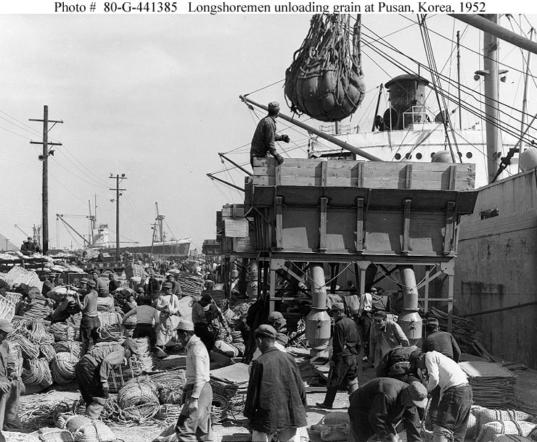
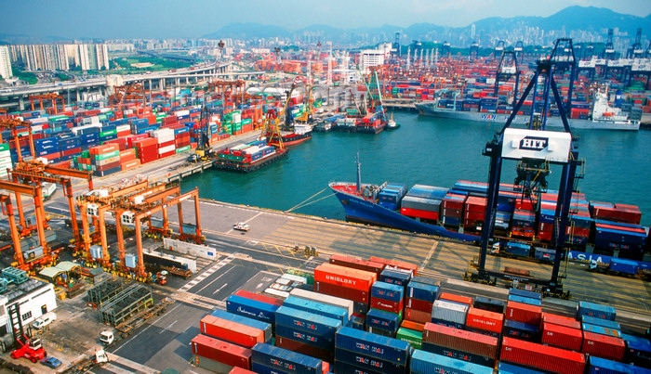
and spawned an Intermodal Shipping Container Ecosystem
90% of all cargo now shipped in a standard container
Order of magnitude reduction in cost and time to load and unload ships
Massive reduction in losses due to theft or damage
Huge reduction in freight cost as percent of final goods (from >25% to <3%)
massive globalizations
5000 ships deliver 200M containers per year

Slide 18
Did you figure it out?
It’s like our code and environment to run the code.
A problem in development and deployment.

Slide 19

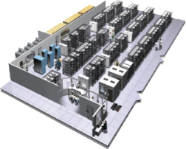
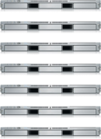
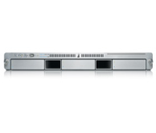
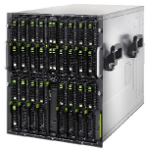

Meet Code and Environment
User DB
Static website
postgresql + pgv8 + v8
Queue
Analytics DB
nginx 1.5 + modsecurity + openssl + bootstrap 2
Do services and apps interact appropriately?
Redis + redis-sentinel
hadoop + hive + thrift + OpenJDK
Multiplicity of Stacks
Background workers
Web frontend
Python 3.0 + celery + pyredis + libcurl + ffmpeg + libopencv + nodejs + phantomjs
Ruby + Rails + sass + Unicorn
API endpoint
Python 2.7 + Flask + pyredis + celery + psycopg + postgresql-client
Production Cluster
Development VM
Public Cloud
Multiplicity of hardware environments
QA server
Can I migrate smoothly and quickly?
Disaster recovery
Customer Data Center
Contributor’s laptop
Production Servers

Slide 20
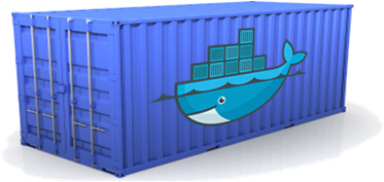
We need a shipping container system for code
Static website
User DB
Web frontend
Queue
Analytics DB
Do services and apps interact appropriately?
Multiplicity of Stacks
An engine that enables any payload to be encapsulated as a lightweight, portable, self-sufficient container…
…that can be manipulated using standard operations and run consistently on virtually any hardware platform
Multiplicity of hardware environments
Can I migrate smoothly and quickly
Development VM
QA server
Customer Data Center
Public Cloud
Production Cluster
Contributor’s laptop

Slide 21
Why containers matter?
 | Physical Containers | Docker
Content Agnostic | The same container can hold almost any type of cargo | Can encapsulate any payload and its dependencies
Hardware Agnostic | Standard shape and interface allow same container to move from ship to train to semi-truck to warehouse to crane without being modified or opened | Using operating system primitives (e.g. LXC) can run consistently on virtually any hardware—VMs, bare metal, openstack, public IAAS, etc.—without modification
Content Isolation and Interaction | No worry about anvils crushing bananas. Containers can be stacked and shipped together | Resource, network, and content isolation. Avoids dependency hell
Automation | Standard interfaces make it easy to automate loading, unloading, moving, etc. | Standard operations to run, start, stop, commit, search, etc. Perfect for devops: CI, CD, autoscaling, hybrid clouds

Slide 22
 | Physical Containers | Docker
Highly efficient | No opening or modification, quick to move between waypoints | Lightweight, virtually no perf or start-up penalty, quick to move and manipulate
Separation of duties | Shipper worries about inside of box, carrier worries about outside of box | Developer worries about code. Ops worries about infrastructure.
 | Physical Containers | Docker
Highly efficient | No opening or modification, quick to move between waypoints | Lightweight, virtually no perf or start-up penalty, quick to move and manipulate
Separation of duties | Shipper worries about inside of box, carrier worries about outside of box | Developer worries about code. Ops worries about infrastructure.

Slide 23
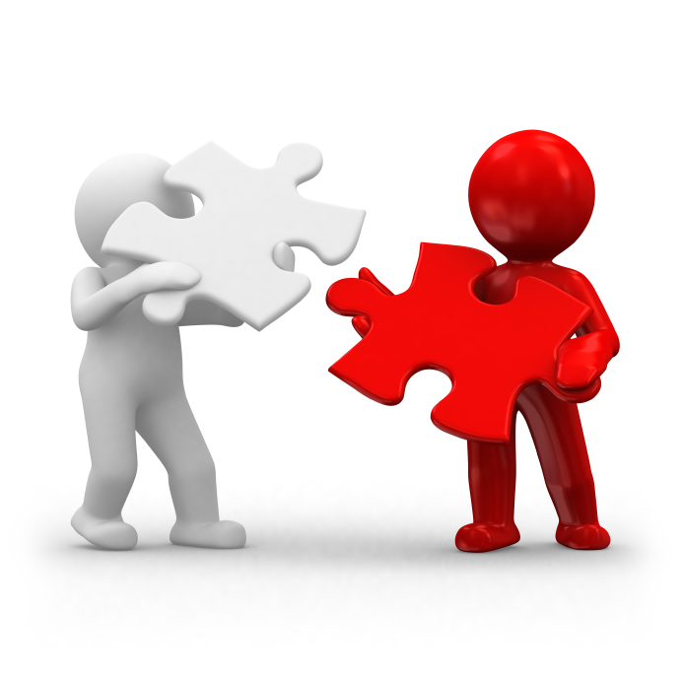
Now everyone happy!
Build once, run anywhere
Ops
Devs
Configure once, run anything

Slide 24
For Developers
Build once…run anywhere
A clean, safe, hygienic and portable runtime environment for your app.
No worries about missing dependencies, packages and other pain points during subsequent deployments.
Run each app in its own isolated container, so you can run various versions of libraries and other dependencies for each app without worrying
Automate testing, integration, packaging…anything you can script
Reduce/eliminate concerns about compatibility on different platforms, either your own or your customers.
Cheap, zero-penalty containers to deploy services? A VM without the overhead of a VM? Instant replay and reset of image snapshots? That’s the power of Docker

Slide 25
For Ops / Devops
Configure once…run anything
Make the entire lifecycle more efficient, consistent, and repeatable
Increase the quality of code produced by developers.
Eliminate inconsistencies between development, test, production, and customer environments
Support segregation of duties
Significantly improves the speed and reliability of continuous deployment and continuous integration systems
Because the containers are so lightweight, address significant performance, costs, deployment, and portability issues normally associated with VMs

Slide 26
Trying Docker
2
Start experiment

Slide 27
Installing
https://docs.docker.com/engine/installation/
$ sudo apt-get install apt-transport-https ca-certificate
$ sudo apt-get purge lxc-docker* docker.io*
$ sudo echo “deb https://apt.dockerproject.org/repo debian-stretch main” > /etc/apt/source.list.d/docker.list
$ sudo apt-key adv --keyserver hkp://p80.pool.sks-keyservers.net:80 --recv-keys 58118E89F3A912897C070ADBF76221572C52609D

Slide 28
$ sudo apt-get update
$ sudo apt-get install docker-engine
$ sudo service docker start
$ sudo docker info
$ sudo groupadd docker
$ sudo gpasswd –a ${USER} docker
$ sudo service docker restart

Slide 29
Terminology
Image
Read only layer used to build a container. They do not change.
Container
Self contained runtime environment using one or more images. You can commit your changes to a container and create an image.
Hub / Registry
Public or private servers which act as repository where pople can upload images and share what they made.

Slide 30
First Interaction
xathrya@bluewyvern$ docker run -ti ubuntu:12.04 /bin/bash
$ cat /etc/issue
Ubuntu 12.04
We are running a container, open it in interactive mode, and running a command

Slide 31
What docker really do?
Downloaded the image from Hub / Registry
Generated a new container
Created a new file system
Mounted a read/write layer
Allocated network interface
Setup IP
Setup NAT
Executed bash shell in container

Slide 32
Docker Registry
https://hub.docker.com/
Officials and user generated container, such as:
Nginx
Ubuntu
Redis
Mongo
etc

Slide 33
Let’s Try An App
$ docker run -d -P training/webapp python app.py
$ docker ps
You must see something like: 0.0.0.0:32768->5000/tcp
Go to web browser and enter url: localhost:32768
Docker exposed port 5000 (default Python Flask port) to our host in port 32768
$ docker run –d –p 8080:5000 training/webapp python app.py

Slide 34
Some Commands
$ docker run ubuntu /bin/echo hello world
$ docker run -d ubuntu
$ docker images
$ docker ps -a
$ docker stop / start <id>
$ docker inspect <id>
$ docker attach <id>
$ docker commit <id>
$ docker rmi $(docker images -aq)
$ docker rm $(docker ps -aq)

Slide 35
Building Own Image

Slide 36
Actually two ways
Update container created from an image and commit the results to a new image
Create Dockerfile
If you having experience with Vagrant, it’s similar concept.
Dockerfile is a file to create and configure a new image so it can be instanced as container.

Slide 37
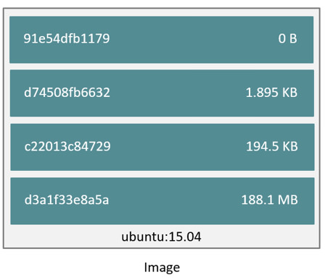

Slide 38
[1] Layering Image
$ docker run -ti training/sinatra /bin/bash
Get the ID from running container
root@ID:/# gem install json
root@ID:/# exit
$ docker commit -m “Added json gem” -a “Xathrya” ID xathrya/sinatra:v2:

Slide 39
[2] Using Dockerfile
https://docs.docker.com/articles/dockerfile_best-practices/
Useful command: FROM, RUN, WORKDIR, EXPOSE, CMD

Slide 40
$ mkdir task1 && cd task1
$ nano Dockerfile
FROM ubuntu:14.04
RUN apt-get update && apt-get install -y ruby ruby-dev
RUN gem install sinatra
ENV HOSTNAME sinatra
$ docker build -t xathrya/newsinatra:v1 .
$ docker images

Slide 41
Container Network

Slide 42
$ docker network ls
$ docker network create -d bridge net-bridge
$ docker run -d --net=net-bridge --name ruby training/sinatra

Slide 43
Volume & Storage

Slide 44
Specially-designated directory within one or more containers that bypasses the Union File System. Useful for persistent or shared data.
Initialized when container is created.
Can be shared and reused among containers
Changes to data volume will not be included when you update image.
Data volume persist even if container is deleted.

Slide 45
$ docker run -d -P --name web -v /webapp training/webapp python app.py
mapped automagically chosen by docker engine
$ docker run -d -P --name web -v /src/webapp:/opt/webapp training/webapp python.py
map /src/webapp (host) to /opt/webapp (container)

Slide 46
And much more!

Slide 47
See https://docs.docker/com/engine/tutorials/

Slide 48
Stack Example: DAMP
3
Docker + Apache + MySQL + PHP.

Slide 49
Like Playing Lego
Add container you need, like a component, by their function.
Every container has similar and uniform concept.
Stack the container, to create complex system.
No need to worry about detail, focus and what you need.
Need to change a component? Just change it
Upgrade version?
Rollback?

Slide 50
Stack: MySQL
$ docker run -p 3900:3306 --name mysql –e MYSQL_ROOT_PASSWORD=toorsql -d mysql:latest
$ mysql -u root -p -h 127.0.0.1 –p 3900
mysql> CREATE USER ‘php’@’%’ IDENTIFIED BY ‘pass’;
mysql> GRANT ALL PRIVILEGES ON *.* TO ‘php’@’%’ WITH GRANT OPTION;
mysql> FLUSH PRIVILEGES;

Slide 51
Stack: Apache (Dockerfile)
FROM ubuntu:12.04
RUN apt-get update
RUN apt-get install -y apache2
RUN apt-get install -y php5 php5-common php5-cli php5-mysqli php5-curl
EXPOSE 80
CMD [“/usr/sbin/apache2ctl”, “-D”, “FOREGROUND”]

Slide 52
$ docker build –t xathrya/apache:v1 .
$ docker images
$ docker run -d -p 8080:80 --name apache --link mysql:mysql -v /var/www/html:/var/www/html xathrya/apache:v1
$ docker ps

Slide 53
Create index.php
<?php
phpinfo();
?>
Try http://localhost:8080/

Slide 54
<?php
$dsn = ‘mysql:host=‘.gethostbyname(‘mysql’);
$usr = ‘php’;
$pwd = ‘pass’;
Try {
$dbh = new PDO($dsn, $usr, $pwd);
} catch (PDOException $e) {
die (‘Connection failed: ’ . $e->getMessage());
}
echo ‘Connection made!!!’;
?>

Slide 55
DevOps and Modern Day in Software Engineering
4
Neet Dave the developer and Oscar the Operations

Slide 56
DevOps is
Development + Operations
Culture, movement, or practice that emphasizes the collaboration and communication of both software developers and other IT professionals while automating the process of software delivery and infrastructure changes.
Environment where building, testing, and releasing software can happen rapidly, frequently, and more reliably

Slide 57
Set of Toolchains
Code – code development and review, continuous integration tools
Build – version control tools, code merging, build status
Test – test and results determine performance
Package – artifact repository, application pre-deployment staging
Release – change management, release approvals, release automation
Configure – infrastructure configuration and management
Monitor – application performance monitoring

Slide 58
To name a few
Docker (containerization)
Jenkins (continuous integration)
Puppet (infrastructure as code)
Vagrant (virtualization platform)

Slide 59
Effectiveness
To practice DevOps effectively, software application have to meet set of Architecture Significant Requirements (ASRs)
Deployability
Modifiability
Testability
Monitorability
Most of time, microservice architectural style is becoming standard for building continuous deployed systems.

Slide 60
Three Ways Principle
Systems Thinking
Amplify Feedback Loops
Culture of Continual Experimentation and Learning

Slide 61
Scope of Activity
Continuous Integration
Continuous Delivery
Continuous Testing
Continuous Monitoring

Slide 62
Continuous Integration
Practice of Agile Development
Developer or Team of Developer is given sub task
For large project it might have multiple teams developing different tasks.
At the end, all tasks must be integrated to build whole application.
CI force devs to integrate individual work with each other as early as possible.

Slide 63
Continuous Delivery
Step after integrating, deliver to next stage of application delivery lifecycle.
The goal is to get the new features that devs created as soon as possible to QA and to production.
Not all integration should come to QA, only good one at a time.
In terms of functionality, stability, and other NFSs
In essence: practice of regularly delivering application to QA and operations for validation and potential release to customers.

Slide 64
Continuous Testing
Process of executing automated tests
Scope of testing:
Validating bottom-up requirements
Validating user stories to assessing system requirement associated with overarching business goals
Object is provided by previous phase
Give (fast) feedback to development regarding the level of business risk in latest build.

Slide 65
Continuous Monitoring
Detect compliance and risk issues associated with organization financial and operational environment.
Correct or replace weak or poorly designed controls

Slide 66

The Conflict
Earlier: Devs vs Ops

Slide 67
Continuous Integration setup consists of
Running unit test
Compiling service
Build Docker image that we run and deploy
Pushing final image to Docker registry
Docker registry might be local repository.
https://docs.docker.com/registry/deploying/

Slide 68
Deployment might depends on infrastructure or cloud provider. Few cloud providers support Docker image:
Amazon EC2 Container Service
Digital Ocean
Giant Swarm

Slide 69
What’s Next?
5
Futures of docker

